Slide 1
Personal Decision Making Assistant
M. Janga Reddy Pisupati Mounika 14R01A0539
Internal guide Thota Aashish 14R01A0555
Prashant Jedidiah 14R01A0524
Rajdeep 14R01A0544

Slide 2
Sections Covered
Abstract
Introduction
Requirements
Modules Implemented
Results
References

Slide 3

What Is it All About?
The purpose of this project is to define scope and requirements of a Personal Decision Making Assistant – PDA for a leading consulting house who wanted to empower its consultants in structured decision-making.
Currently the employees waste significant time to convene and run meetings for arriving at meaningful decisions.
As a first step, the proposed system – PDA will provide an online structured assistance to quickly prioritize items such as actionable items, initiatives, or to-dos.

Slide 4
Abstract
PDA will provide a web-based formal tool for consultants to quickly prioritize items such as actionable items, initiatives, or to-dos using a structured pair-wise comparison technique.
It is a technique used in decision-making process to rank or prioritize items on a relative scale of importance against a criterion.

Slide 5
Functional Requirements
Designer and consultant must have a valid user ID and password to login to the system.
After a valid log in, the system shows the upload design page to the designer and view designs and rate page to the consultant.
Designer can add design and the consultant can rate the design.
The addition of designers and consultants is managed by the admin.

Slide 6
Non-Functional Requirements
Quick and authenticated access to designs/combinations via Desktop.
Easy ranking method.
Minimize Storage Space.

Slide 7
Modules
The System consists of 3 Modules:
1 . Admin Module
2. Designer Login Module
3. Consultancy Login Module

Slide 8
Admin module
Functionalities of admin:-
Register New Designer
Register New Consultant
View Ratings

Slide 9
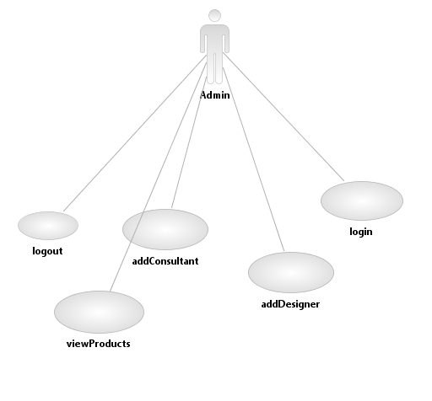
Admin Use Case

Slide 10


Slide 11
Designer module
Functionalities of designer:-
Add New Design

Slide 12
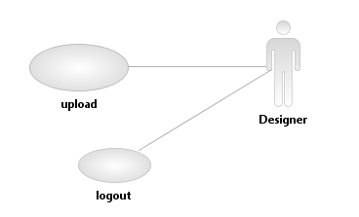
Designer Use Case

Slide 13


Slide 14
Consultant Module
View All Designers
View By Design
Rate Items

Slide 15
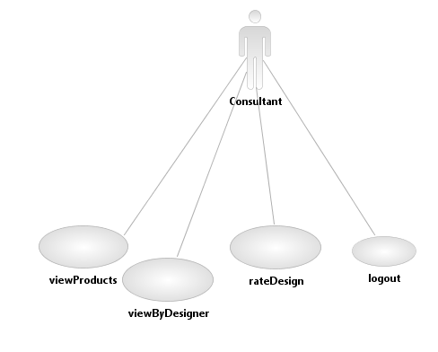
Consultant Use Case

Slide 16


Slide 17
Conclusion
It is a technique used in decision-making process to rank or prioritize items on a relative scale of importance against a criterion.

Slide 18
References
* FOR JAVA INSTALLATION:
https://www.java.com/en/download/
* REFERENCE BOOKS:
Raghu Ramakrishnan - Database Management System, Johannes Gehrke , 2000 - Mc Graw- Hill International Edition.
Roger S. Pressman, 1997 - Software Engineering, Fourth Edition, McGraw-Hill International Edition.
Herbert Schildt , 2011 - The Complete Reference Java, Mc Graw- Hill International Edition.
A. A. Puntambekar , 2015 - Web Technologies, Technical Publications.

Slide 19
Thank You

